Slide 1
Ticket shop application
Author: Giuroiu Tudor

Slide 2


General Presentation
The project presented is a Ticket Shop Application. The application serves as a platform for managing and purchasing event tickets, offering users the capability to both make acquisitions and effect updates, a privilege reserved for administrators. The system facilitates user engagement through the creation of individual accounts, enabling login experiences or, alternatively, permitting users to explore the site as guests.

Slide 3
Theoretical fundamentals
E-commerce Application:
- facilitating seamless online transactions
- enabling the buying and selling of event tickets
- electronic fund transfers (simulation)
- facilitating the exchange of data between event-goers and organizers
Web Application:
- user-centered design
- scalability
- robust security measures
- performance optimization
- responsive design
- modularity
Database:
- appropriate database design

Slide 4









IT Technology
Backend
Frontend
Java - main programming language.
HTML – primary design language.
Spring – main framework.
CSS – styling.
Spring Boot – simplify the configurations for the Spring framework.
JavaScript – some frontend functionalities.
Maven – manage dependencies.
Thymeleaf – framework to integrate backend into frontend.
MySQL – SQL dialect.

Slide 5

FUNCTIONALITIES
Event Exploration:
list of events
search further into detailed event pages
Ticket Selection and Basket Management:
introduce a virtual basket
select specific tickets and place them in the basket
User Account Management:
create individual accounts
edit accounts
Ticket Purchase:
proceed to purchase the selected tickets from their virtual basket
Administrative Privileges:
perform CRUD operations on events, tickets, and discount codes
Event Exploration
Ticket Selection
Basket Management
User Account Management
Ticket Purchase
Administrative Privileges

Slide 6
Actors and related access rights
Administrators
Administrators play a crucial role in the system. Their responsibilities include creating and modifying events, managing ticket categories and prices, and overseeing discounts. They can also access and oversee the processed orders.
Administrators have access across the entire application. Beyond the capabilities available to regular customers, administrators can utilize specialized options embedded within event pages specifically designed for content management purposes. This includes the ability to manipulate and oversee the information presented on event pages.

Slide 7
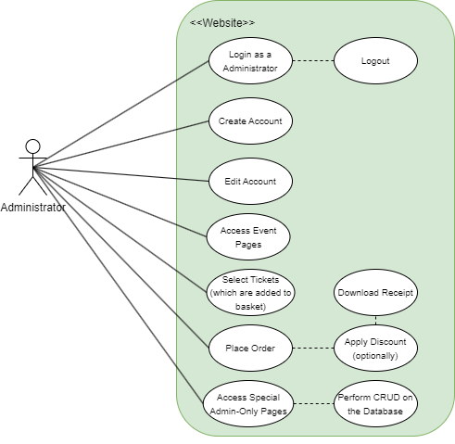
Administrators
Use-case diagram:

Slide 8
Actors and related access rights
CUSTOMERS
The Customer joins the journey of Ticket Shop Application by exploring, selecting, and purchasing event tickets. He actively engages with the platform by creating individual accounts, enabling a personalized and convenient event and ticket selection process. The Customer can also proceed to place an order and receive a receipt.
Customers have access to all the basic and customer-indended features of the application. They cannot access the special area for orders and the special embedded options designed for the admins (home edit, tickets edit, discount code form).

Slide 9
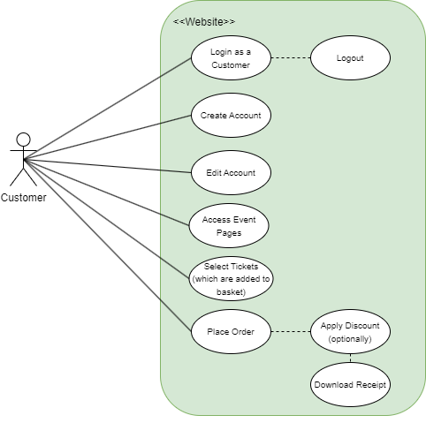
CUSTOMERS
Use-case diagram:

Slide 10
SYSTEM ARCHITECTURe
The system employs the Model-View-Controller (MVC) architecture, providing an organized structure for handling user interactions, managing data, and presenting a seamless experience for both regular users and administrators.
The Model component represents the core of the application, encapsulating the data structure. In the Ticket Shop Application, the Model includes entities such as User, Event, Ticket, Order, OrderDetails, and DiscountCodes.
The View component handles the presentation layer of the application. It encompasses the user interface elements that users interact with. Views include pages for event listings, user authentication and registration, ticket purchase forms, account management, and admin content-management pages.
The Controller component serves as a crucial intermediary between the application's Model and View. Its primary role is managing incoming requests, processing them, and managing the generation of an appropriate response. Within this framework, each significant endpoint or URL is typically associated with a designated controller.

Slide 11
SYSTEM ARCHITECTURE (CONTINUED)
To facilitate interaction with the database, a separate package known as the Data Access Object (DAO) package is employed. The DAO classes within this package are responsible for handling database operations, such as retrieving or persisting data.
The core business logic of the application is typically managed by classes within the Service package. These Service classes act as intermediaries between the Controllers and the DAO classes. They facilitate the abstraction of business operations, providing a layer of insulation between the web layer (Controllers) and the data access layer (DAO).
For addressing the security aspects of the application, a specialized security package is often created. This security package contains essential classes responsible for user authentication and authorization.

Slide 12
Design
UML DIAGRAMS

Slide 13
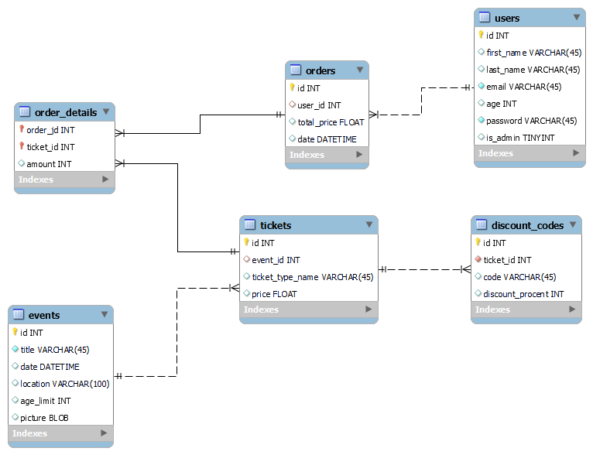
Database diagram

Slide 14
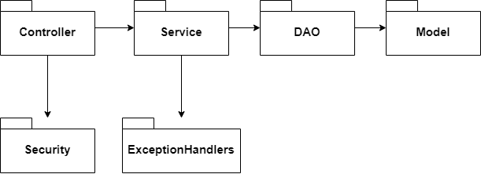
PACKAGE diagram

Slide 15
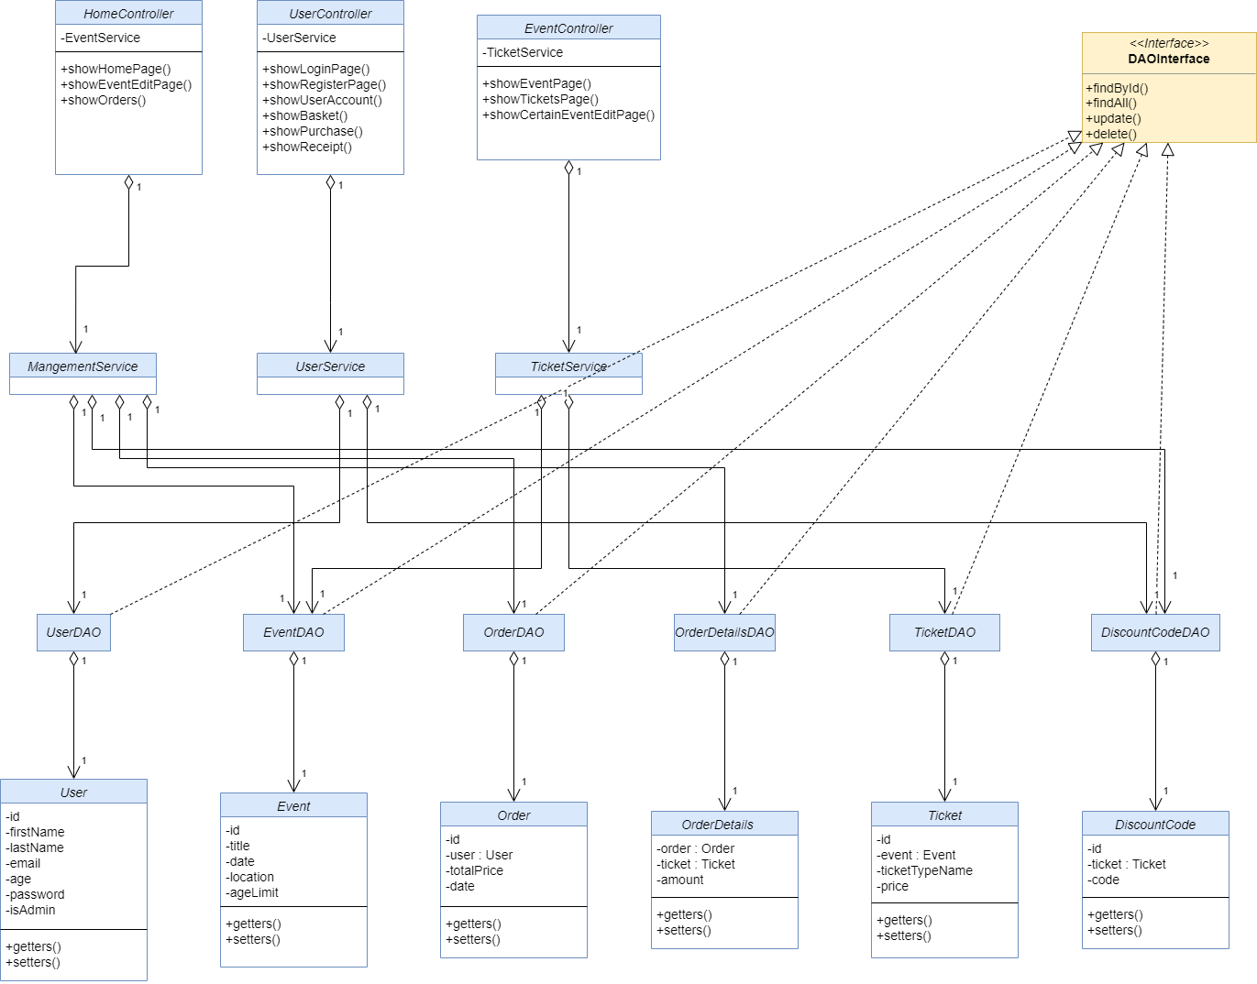
Class diagram

Slide 16
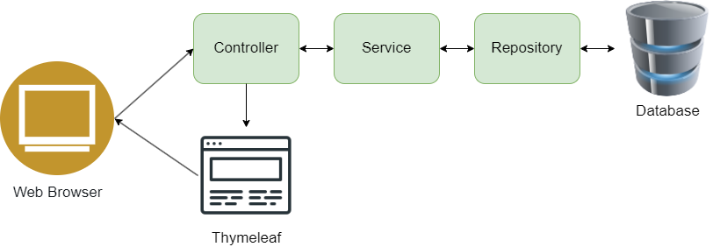
DATA aCCESS diagram

Slide 17
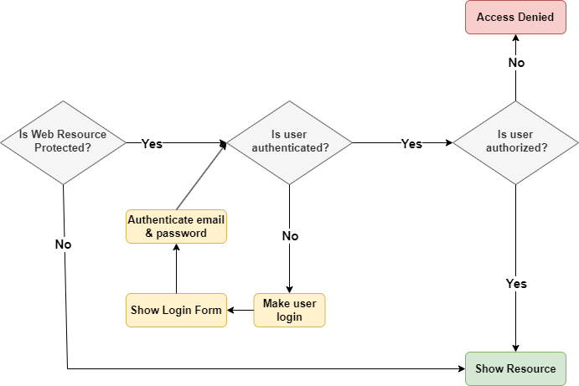
SECURITY diagram

Slide 18
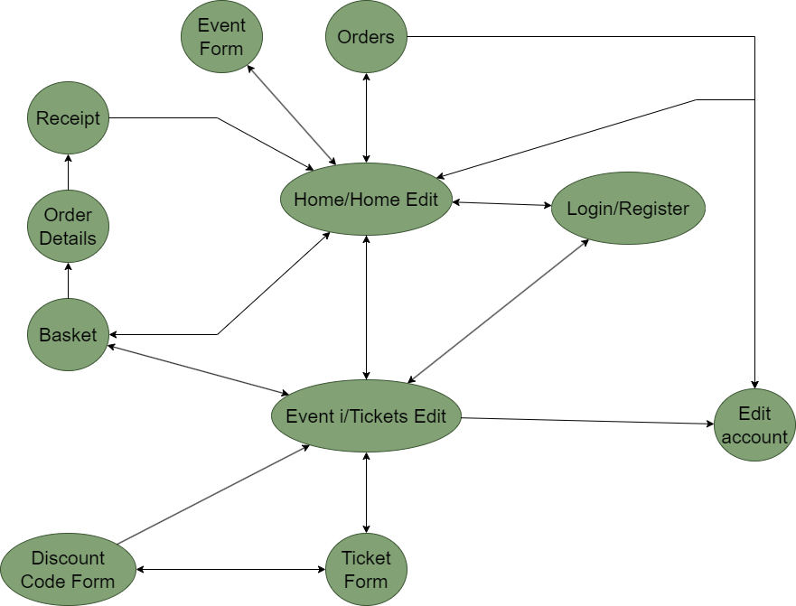
STATE diagram

Slide 19
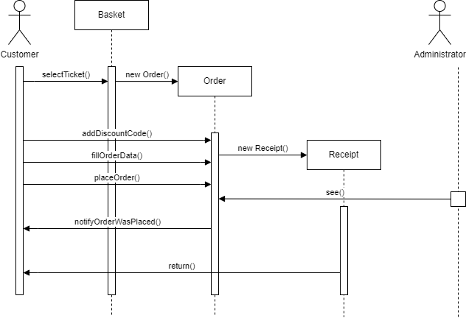
SEQUENCE diagram

Slide 20
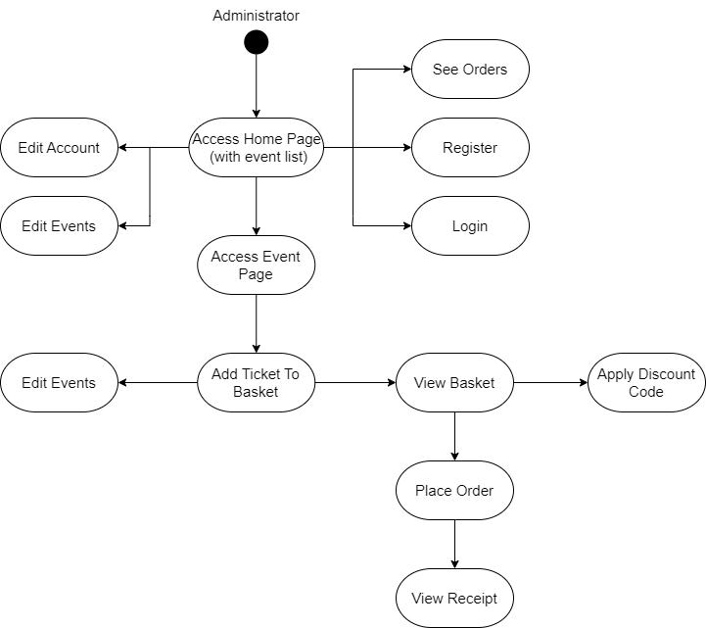
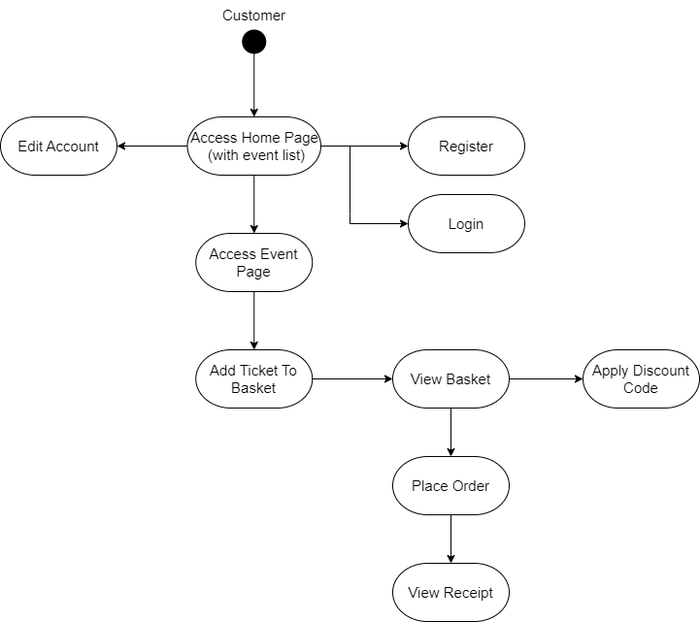
ACTIVITY diagram

Slide 21
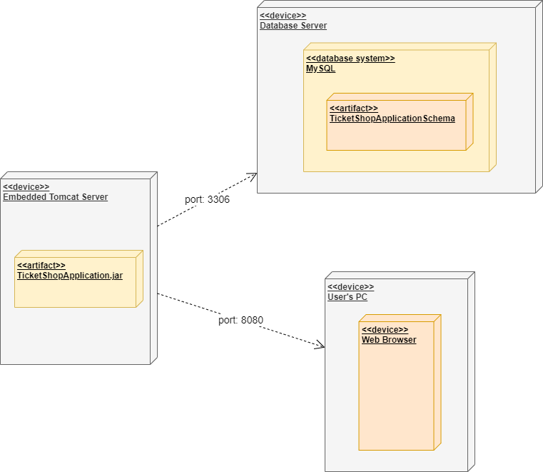
DEPLOYMENT diagram

Slide 22
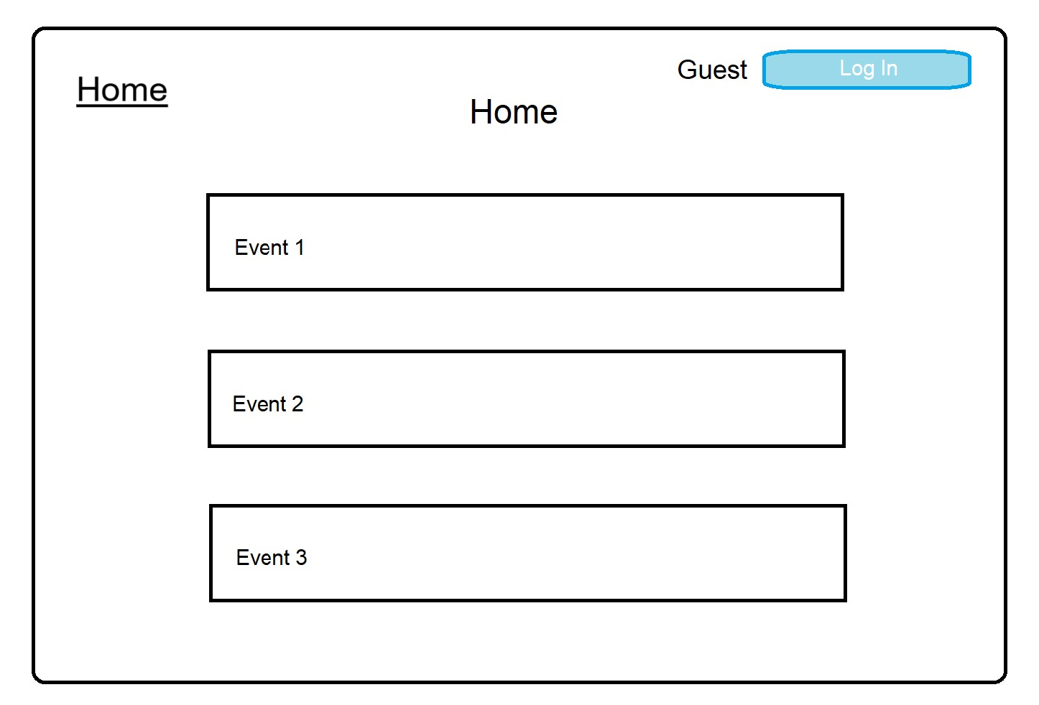
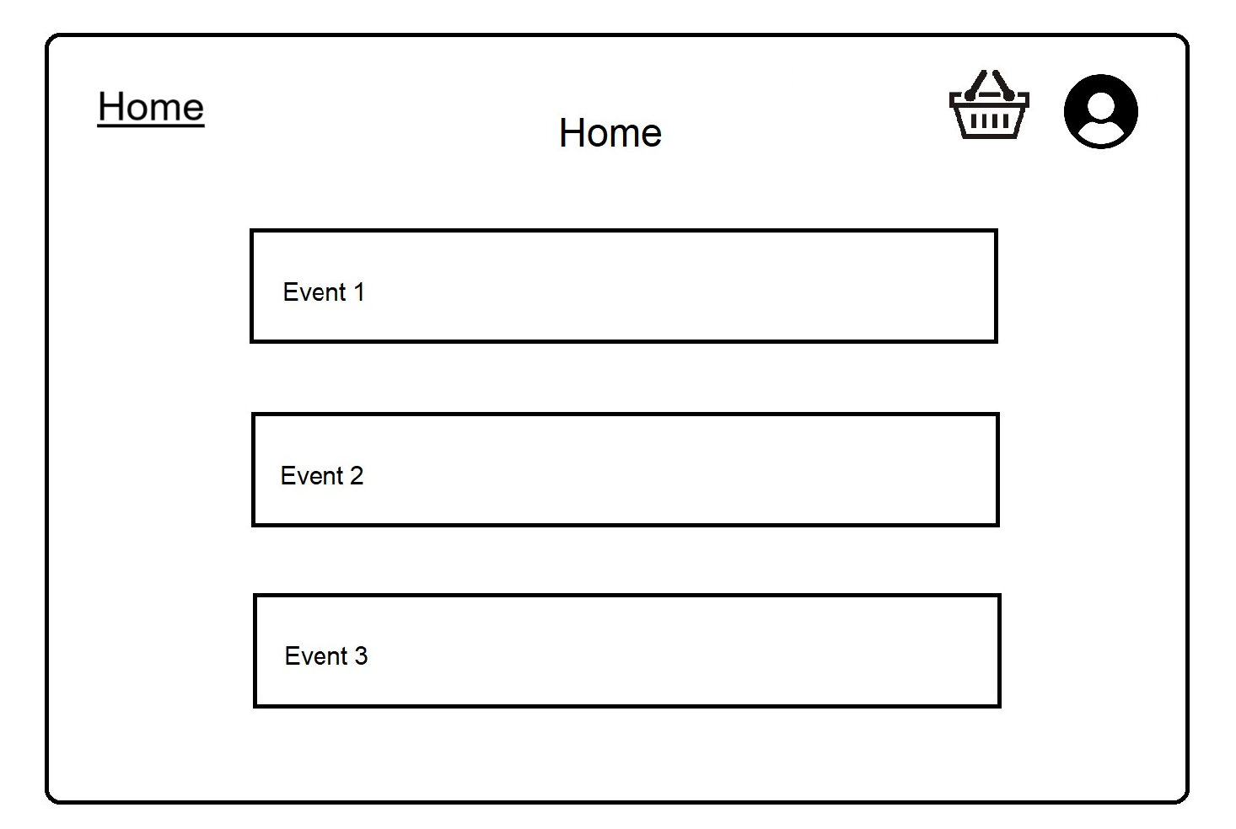
Operation mode

Slide 23
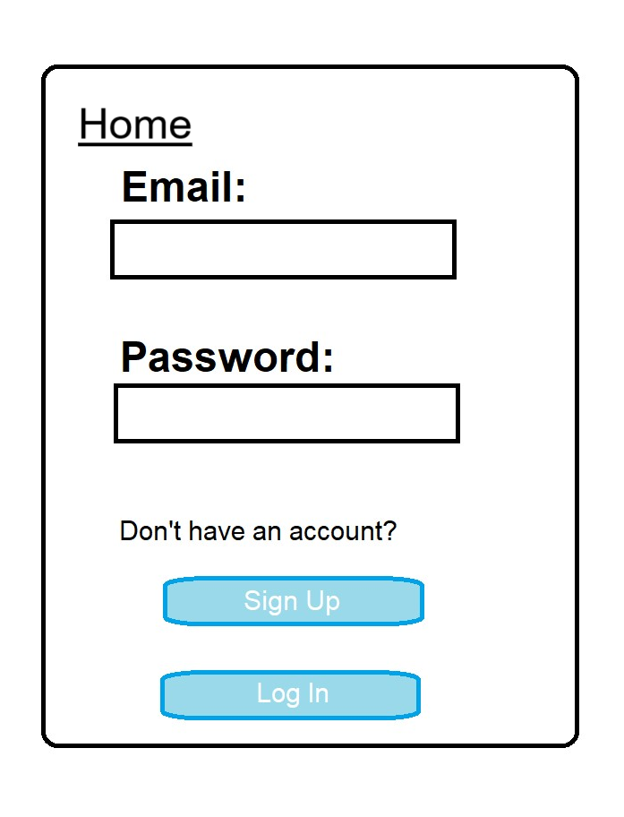
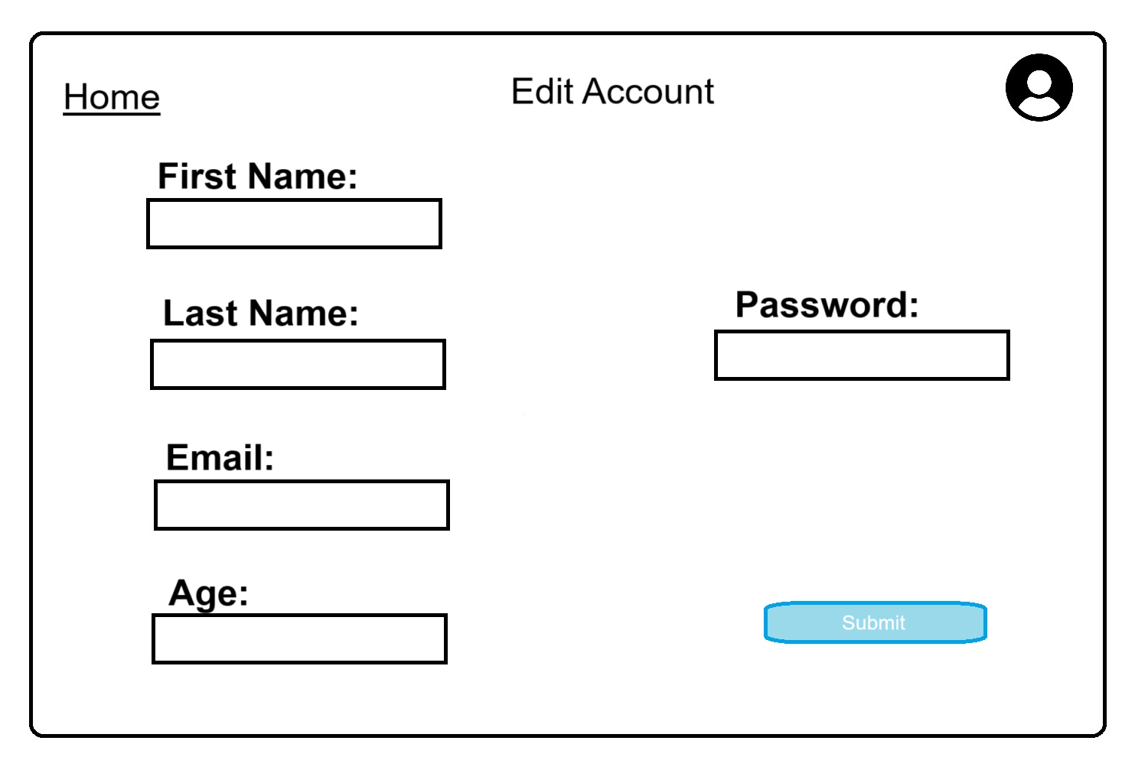
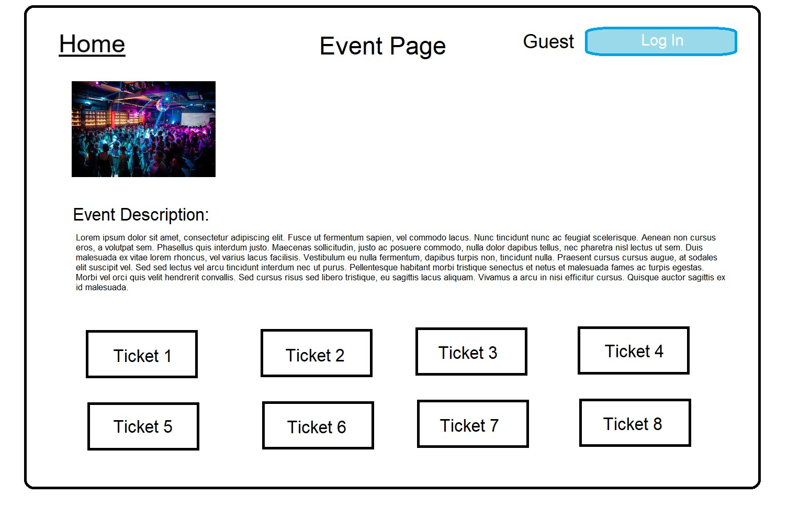
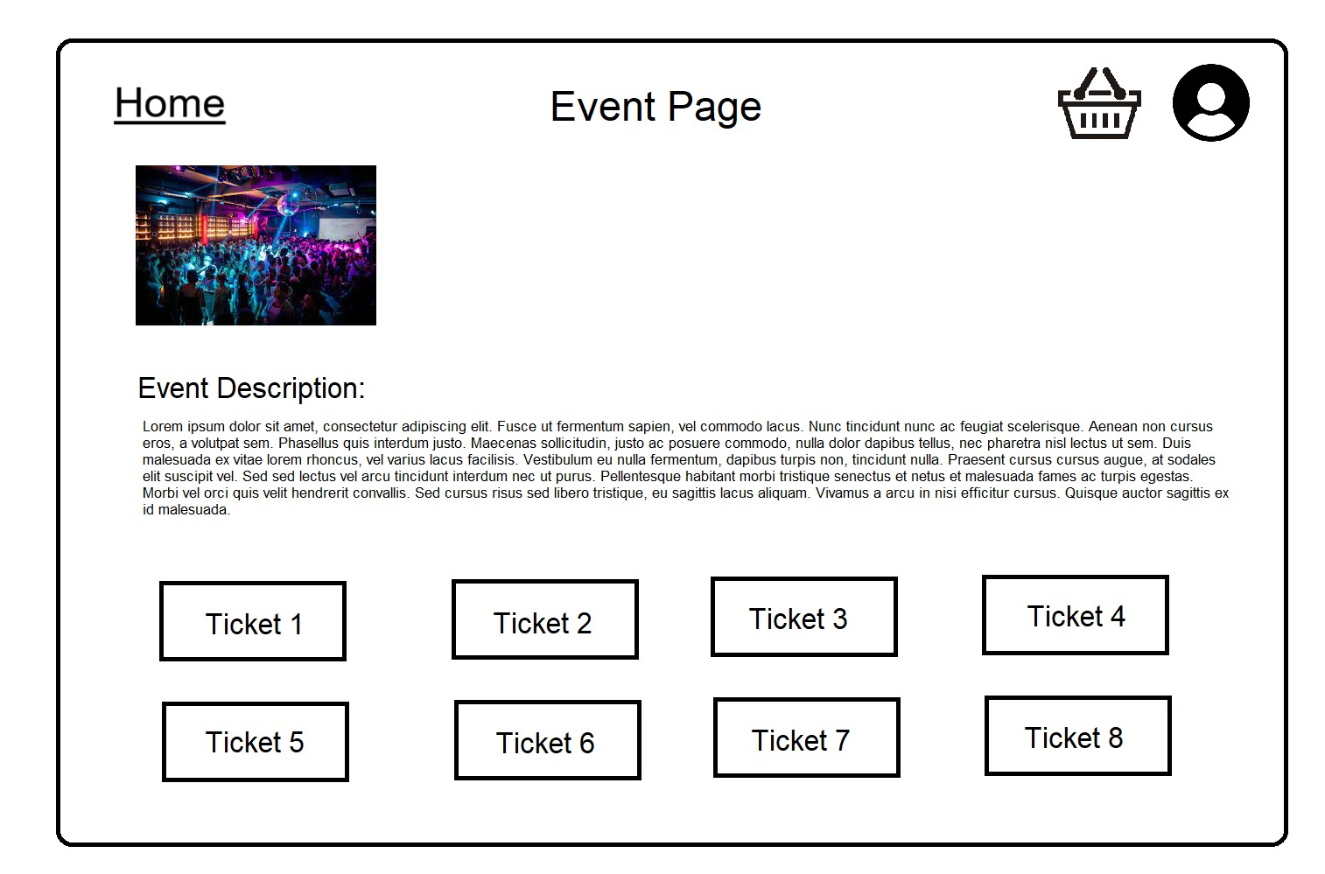

Slide 24
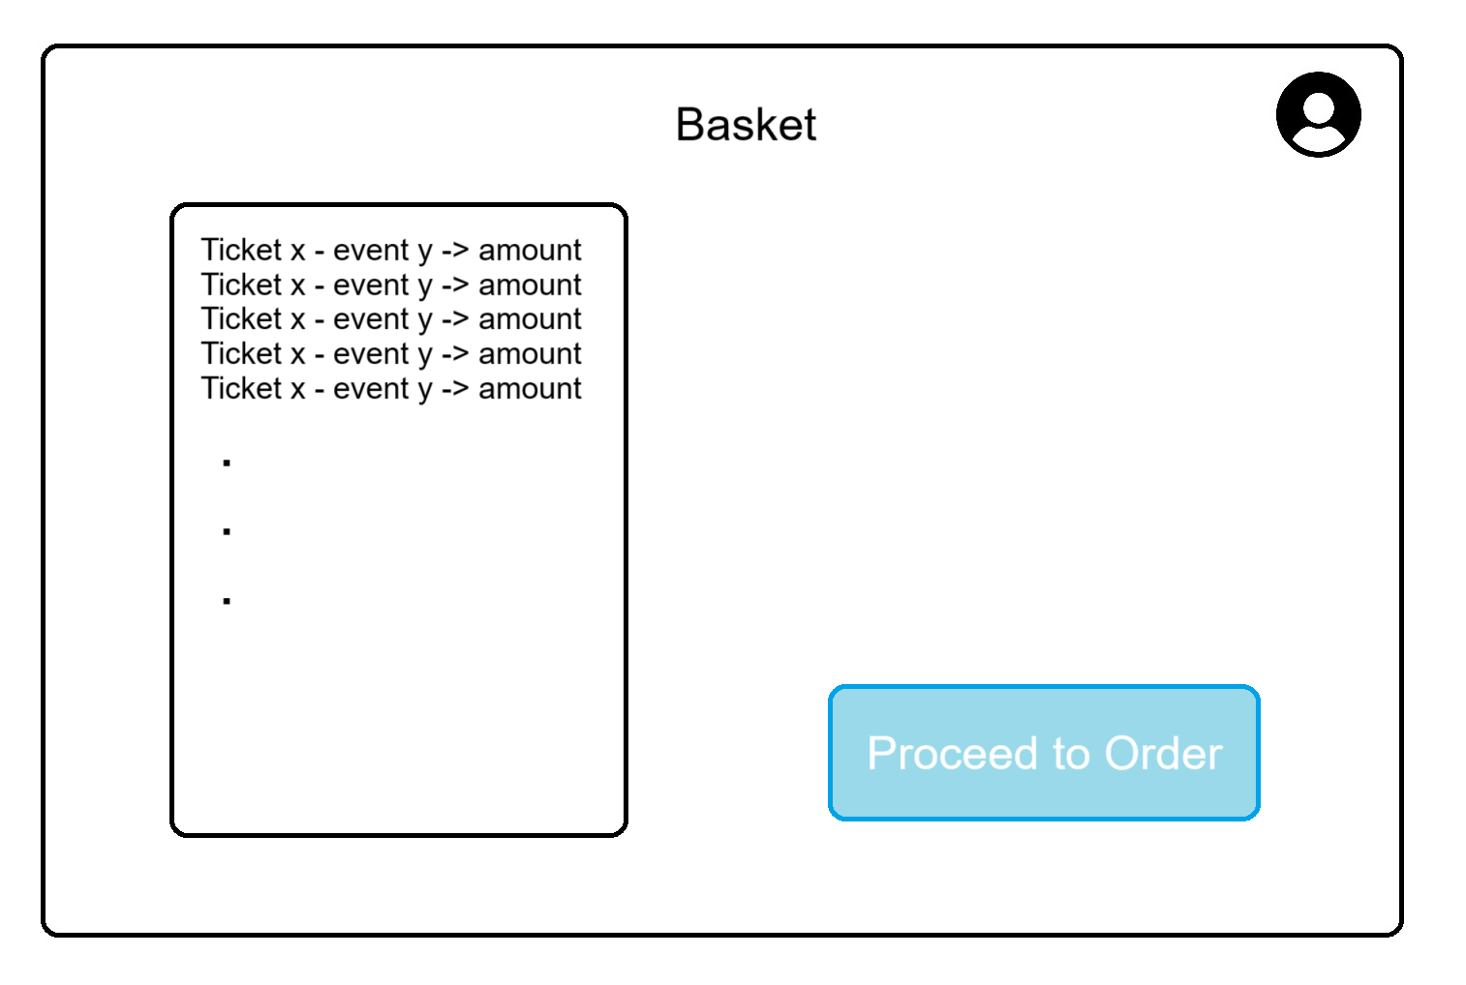
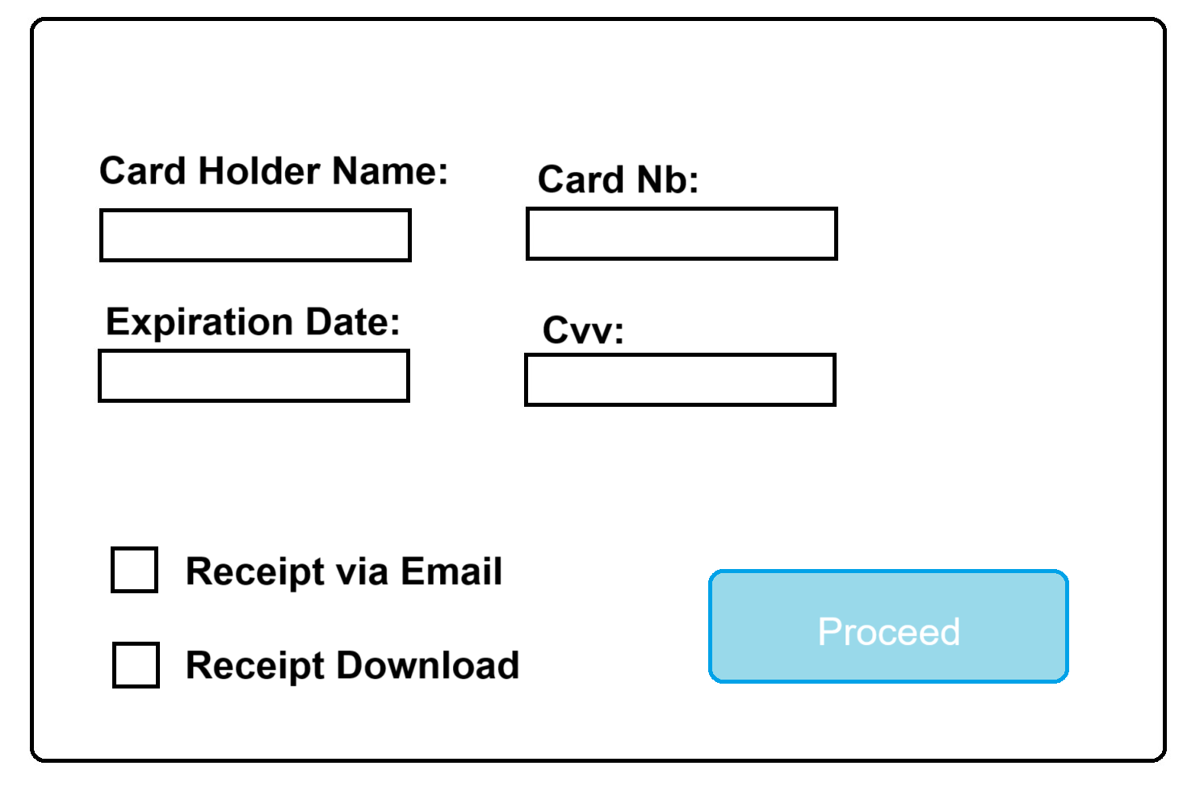
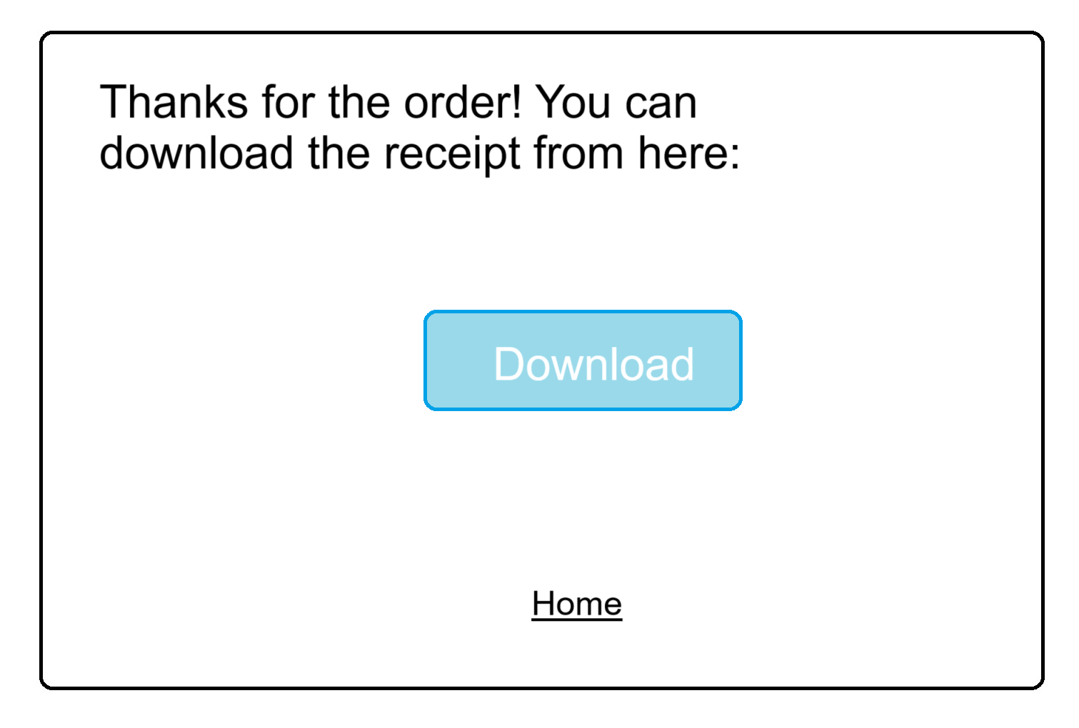

Slide 25
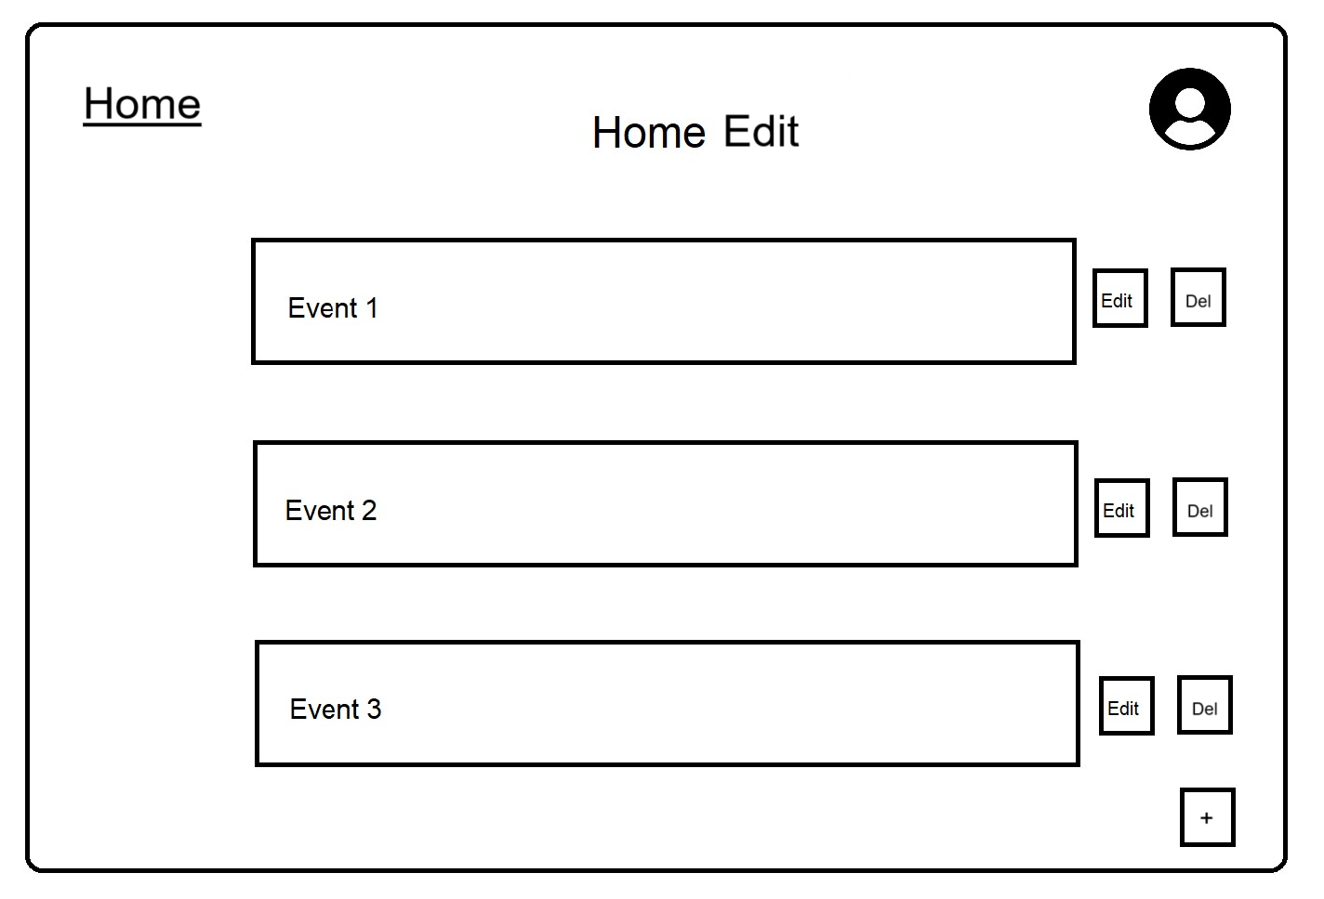
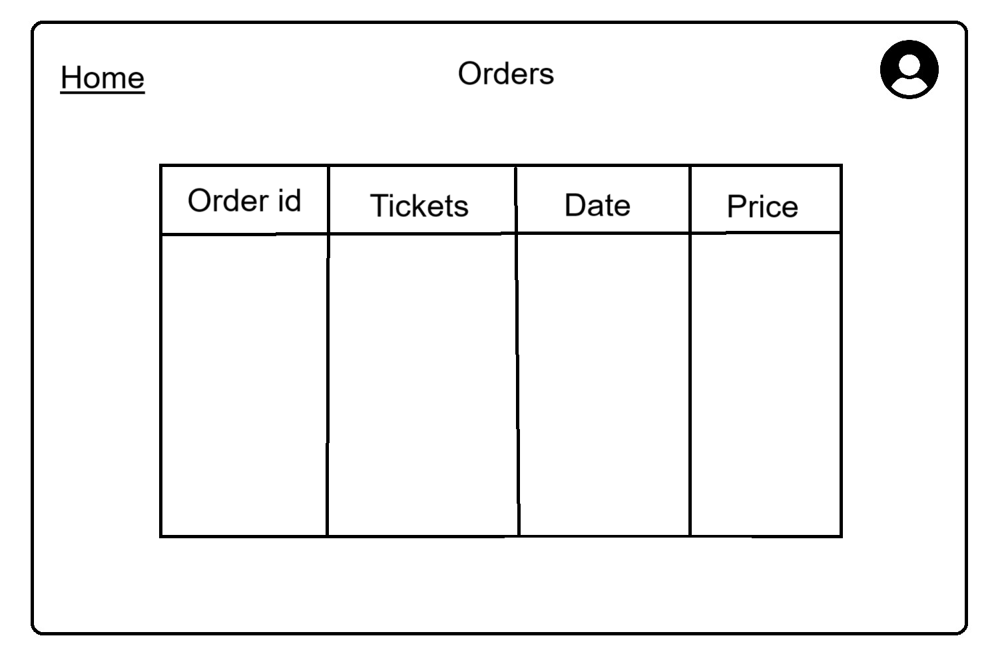
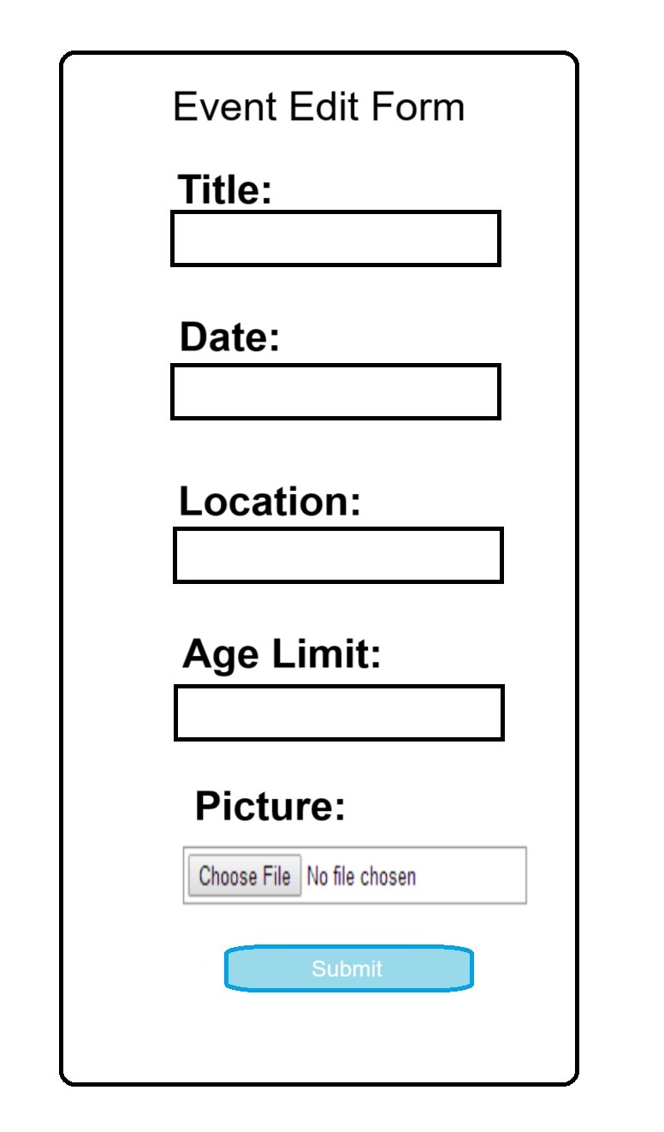
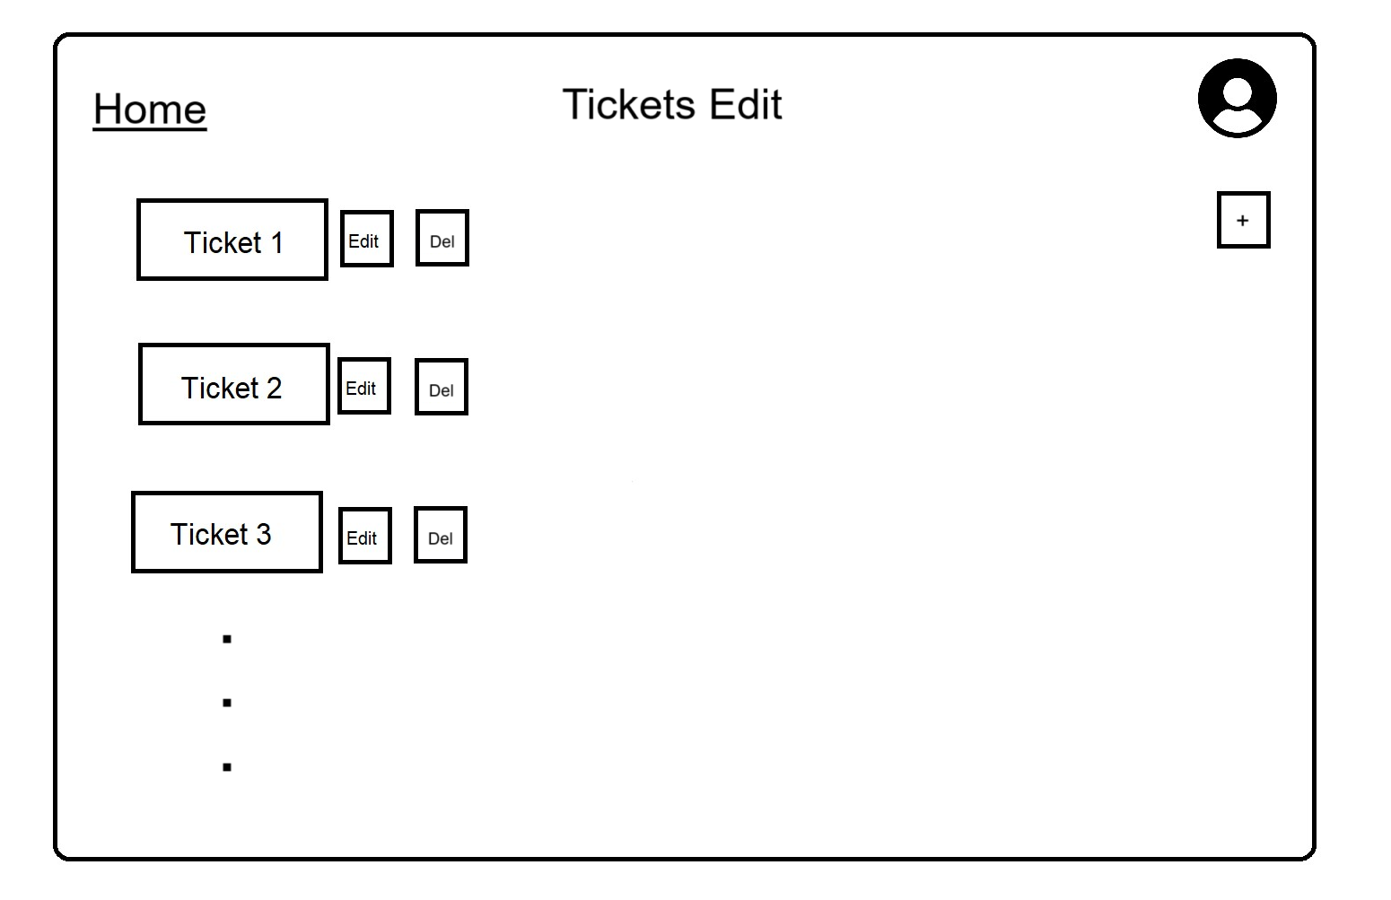
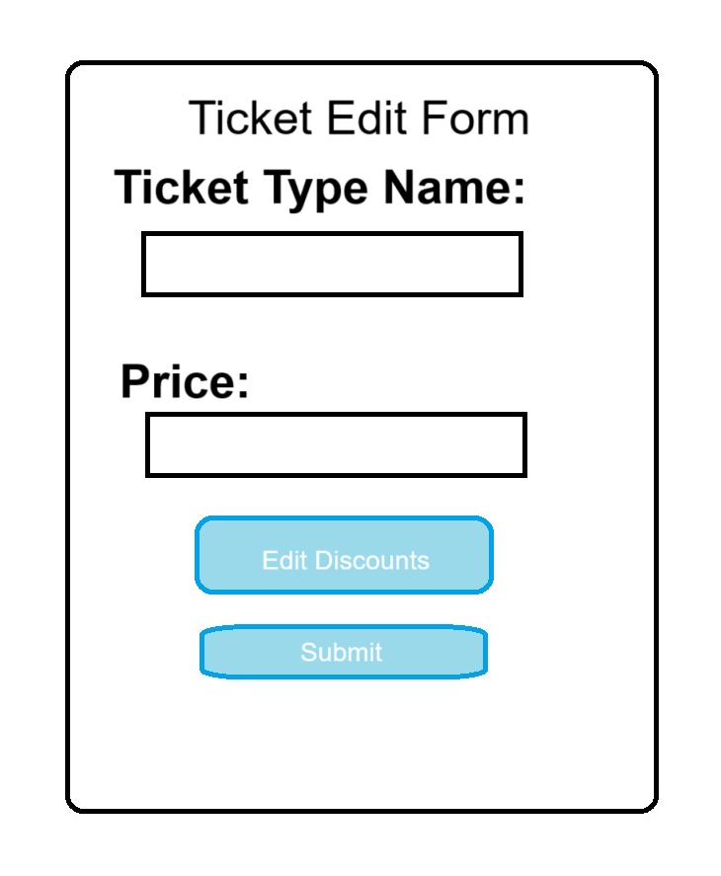
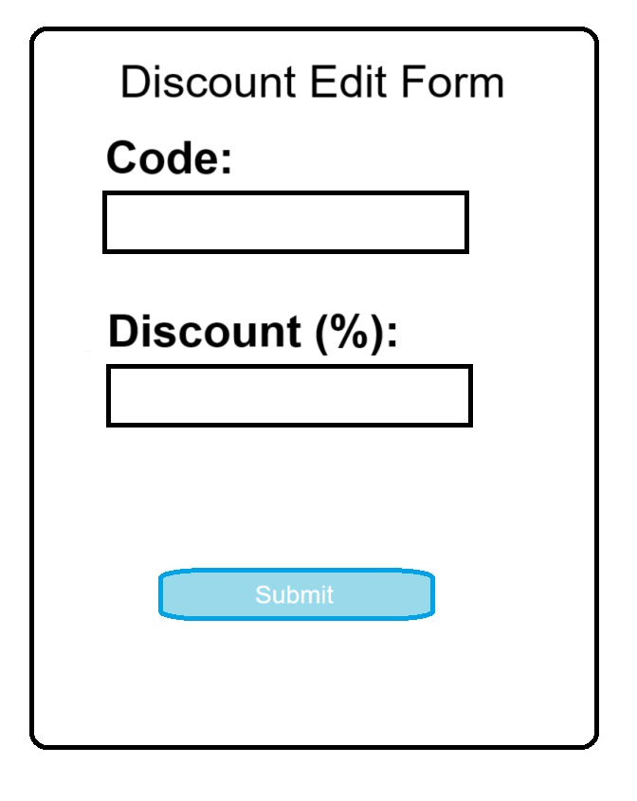

Slide 26
portability
Porting the Ticket Shop Application to another machine involves several steps to ensure a seamless transition. Begin by retrieving the application code and configurations from the version control system, ensuring consistency with the intended version. Adjust environment-specific settings in configuration files, build the application using the appropriate tools, and configure the database connection to align with the target machine. Launch the application and conduct thorough testing to validate its functionality, addressing any issues that may appear.

Slide 27

end

